Slide 1





REC 2022

Slide 2
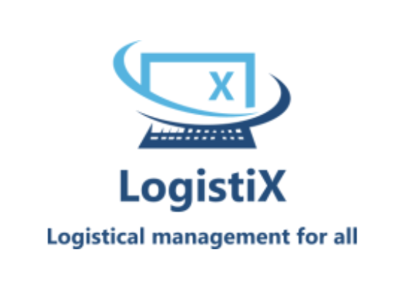
LogistiX
A logistical management tool

Slide 3




Our Team
Zaman Project Team Lead
Software Systems Engineering
Aryan Project Developer
Software Systems Engineering
Kevin Project Developer
Software Systems Engineering
Hasaan Project Developer
Software Systems Engineering

Slide 4

STAKEHOLDER ENGAGEMENT PLAN
Name | About the Stakeholder | How to Engage the Stakeholder
Judges | Judges for the REC Will test project usability and provide feedback and ratings | Produce/Provide and solution to the given problem on time with excellent standards
Zaman | Project Team Lead Leader for Project | Monitor the whole team and provide leadership over the course of project
Kevin | Project Team Member Developer for Project | Ensure work is done on time in a professional manner
Aryan | Project Team Member Developer for Project | Ensure work is done on time in a professional manner
Hasaan | Project Team Member Developer for Project | Ensure work is done on time in a professional manner
User | Project User Will utilize our Project and provide feedback | Satisfy user requirements, provide updates about future development/patch notes

Slide 5

RACI Chart
RACI CHART
 | [Kevin] | [Aryan] | [Hasaan] | [Zaman]
Project planning Docs | R | I | C | I
Lofi/Hifi Prototypes | C | I | I | R
Controller component and integration with model and view | R | R | R | A
View component and GUI | A | R | R | R
Model component | R | R | A | R
R—Responsible A—Accountable C—Consulted I—Informed

Slide 6
SWOT Analysis
STRENGTHS
Our solution is easy to use and understand with a very low initial cost/budget.
WEAKNESSES
New business, might not have much exposure to the Northstar users
S
W
With big dates like Black Friday, Christmas and boxing day coming up. There will be a lot more online purchases.
OPPORTUNITIES
Other similar solutions with the same idea and concept.
THREATS
O
T

Slide 7
Our Solution Contains…
Overview
An oversee of all active trucks and drivers. Including elements such as river’s name, truck number, destination and much more.
Shipment Creation
Creates shipment with appropriate regulations from the Commercial Vehicle Drivers Hours of Service Regulations (SOR/2005-313).
Time Estimation
Obtain an time estimation of a shipment based on distance and average driving speed.
Schedule Planner
Set the driver schedule according to 14 days working, 7 days off schedule with 1 B-train capable driver on each shift.

Slide 8
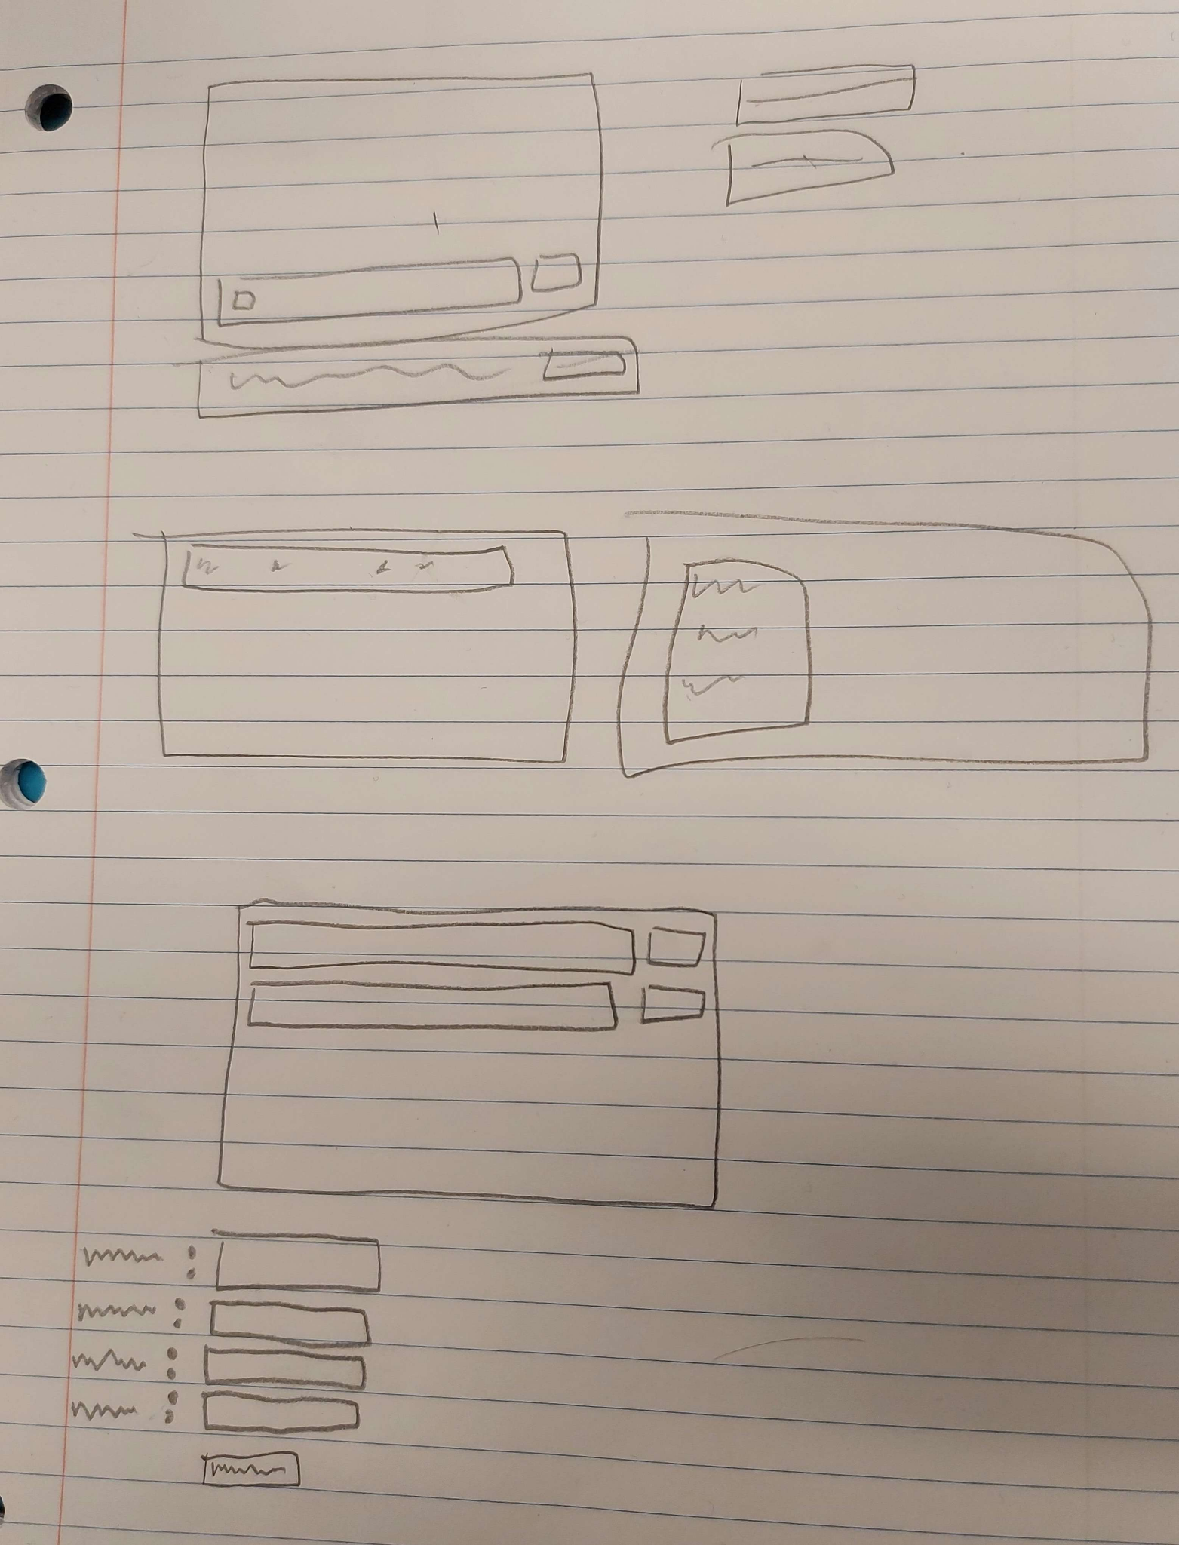

LoFi Prototype

Slide 9
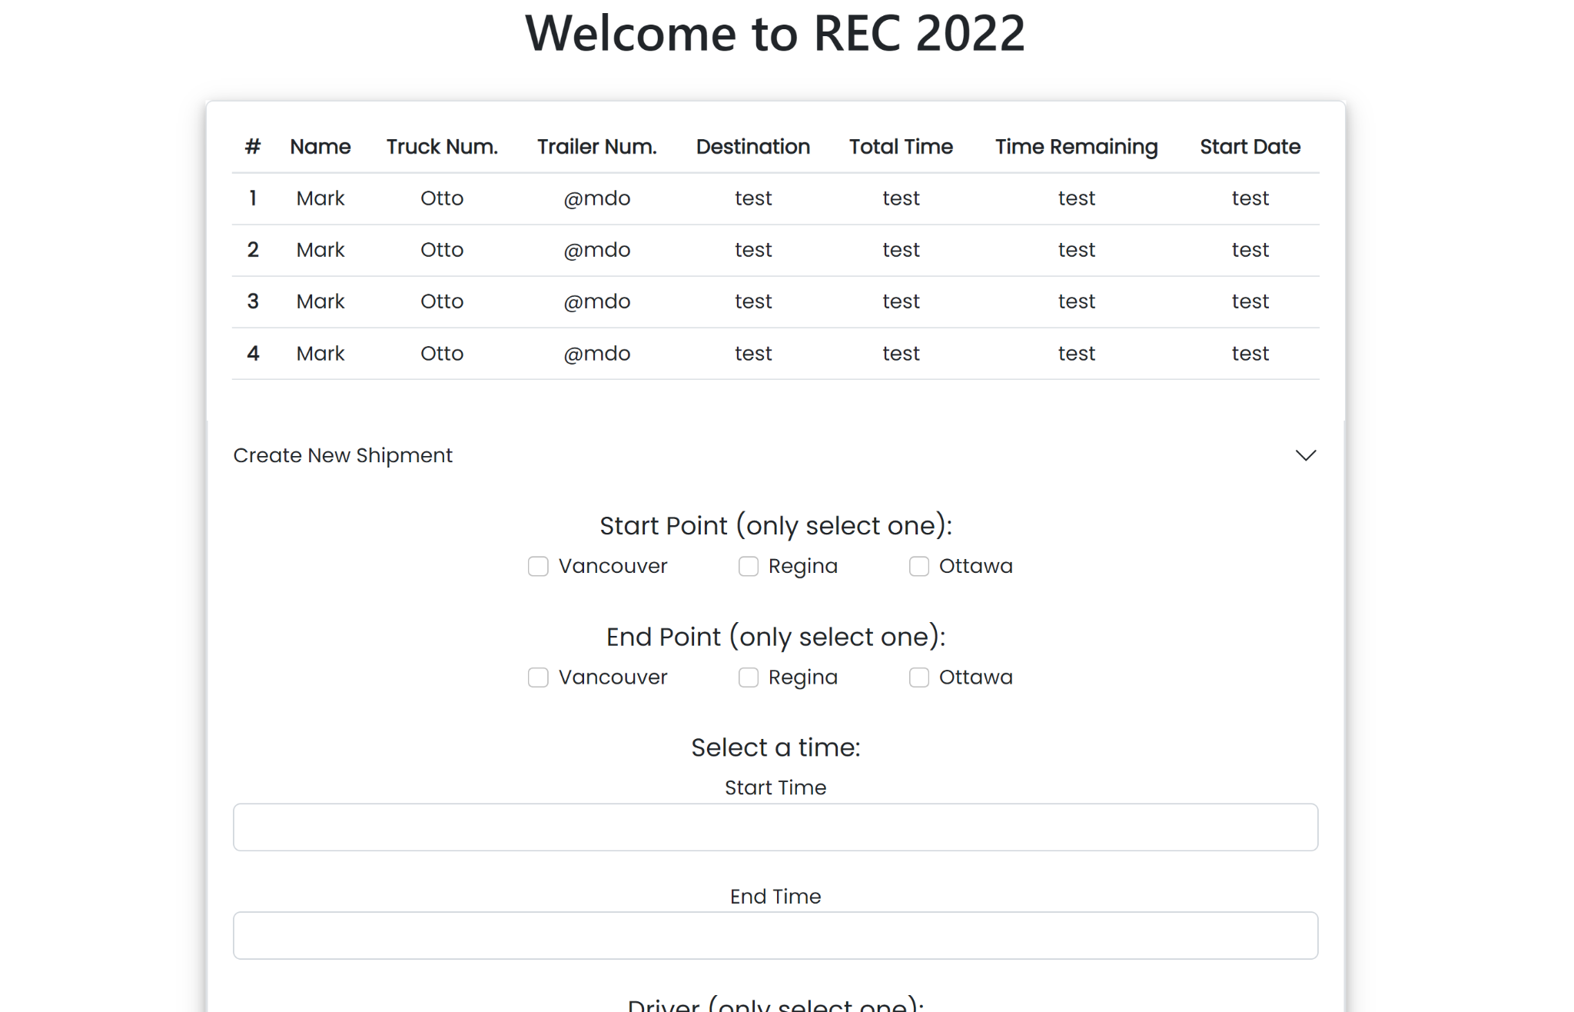
Overview
User guide:
User will see an overview of all active trucks and drivers. This includes their Name,Truck Num.,Trailer Num., Destination,Total Time, Time Remaining and Start Date.

Slide 10
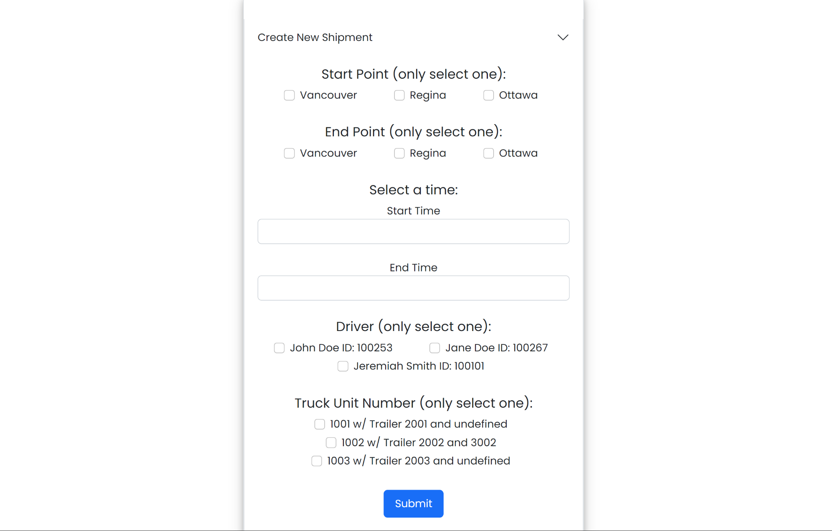
Shipment Creation
User guide:
User will input a start and end point, along with a time, driver and truck unit number, if all the information provided is correct, it will create a new shipment in our database.

Slide 11
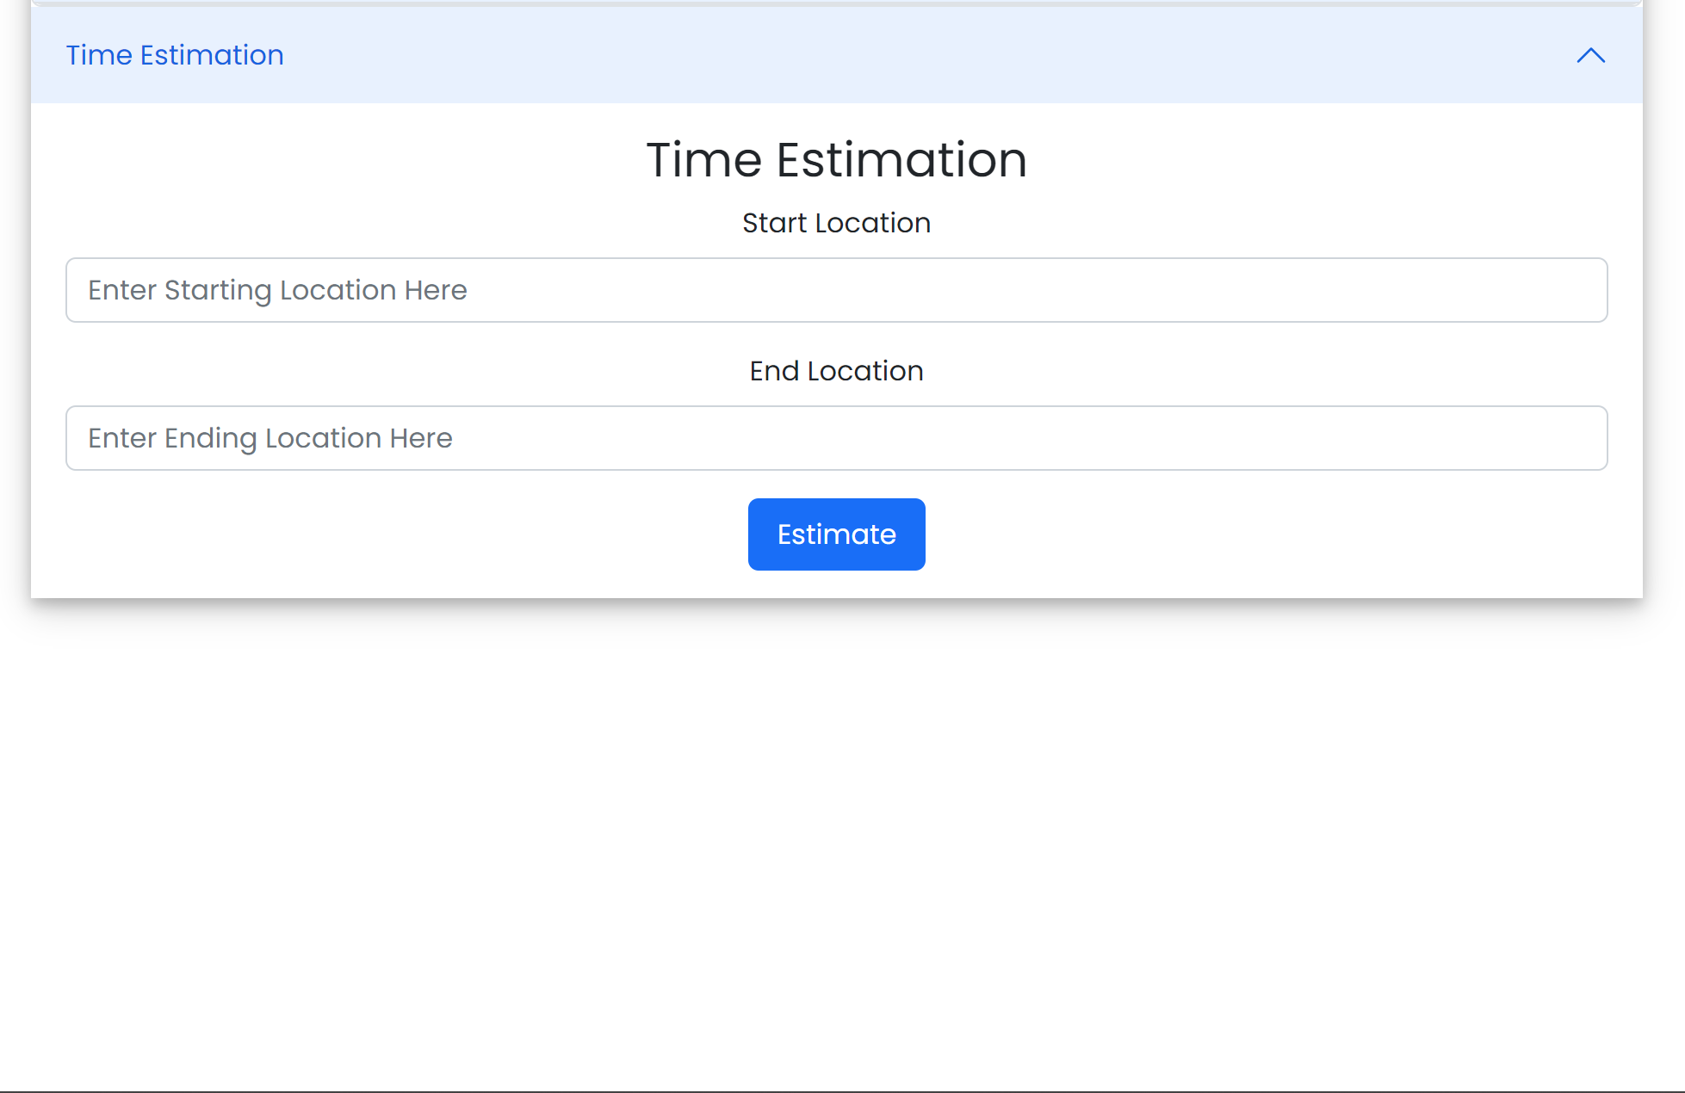
Time Estimation
User guide:
User will input a start and end point, it will return an estimated time of the shipment.

Slide 12
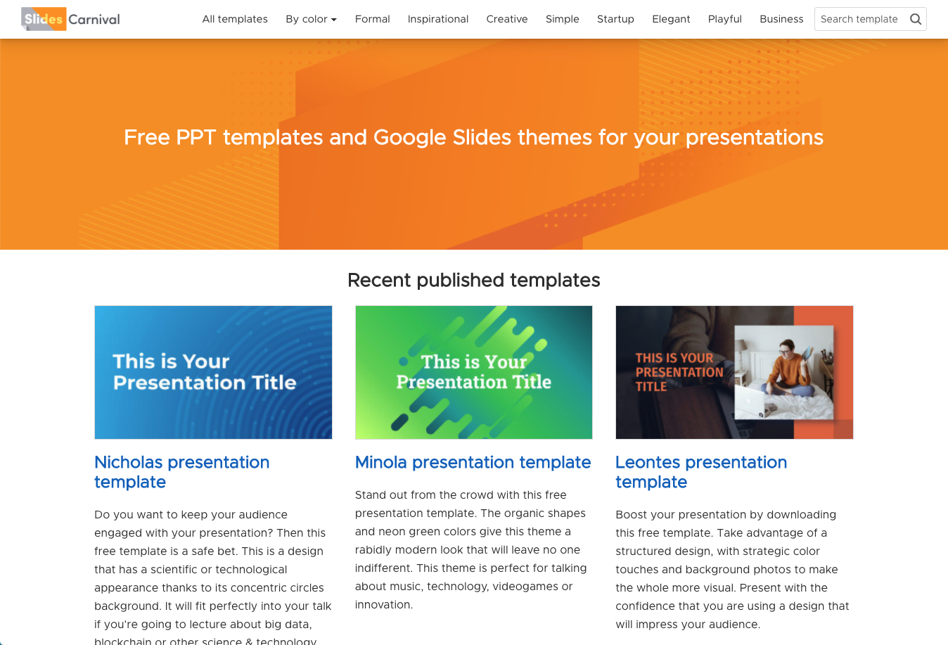
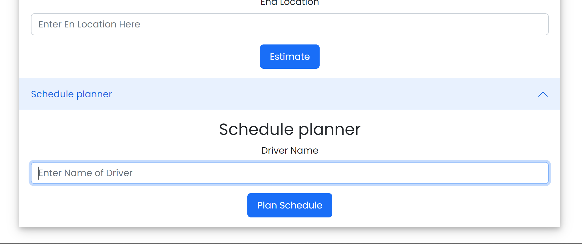
Schedule Planner
User guide:
User will input the name of the driver and plan its schedule

Slide 13

Logistical management made easy, for all.
Use LogistiX.

Slide 14


Credits
Special thanks to all the people and judges that made REC possible.
Any questions?

